Slide 1
Let’s do introductions
What’s your name & department?
Notes:
Image: Research Data Management: making it possible to retrieve data from last year. The Turing Way project illustration by Scriberia. Original version on Zenodo. http://doi.org/10.5281/zenodo.3695300

Slide 2
Thanks for sharing your data!

Slide 3
Establishing your unique identity as a researcher is the start of Research Data Management

Slide 4
How can we identify ourselves uniquely?

Slide 5

Open Researcher Contributor ID
(TU/e is a member institute)
A persistent identifier for a research contributor

Slide 6


Why ORCID ID?
Your unique ID
A linking pin for your research outputs

Slide 7

Your researcher identity becomes part of the open data ecosystem

Slide 8
Do you have your ORCID ID?

Slide 9
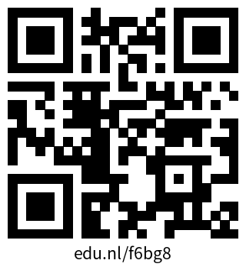
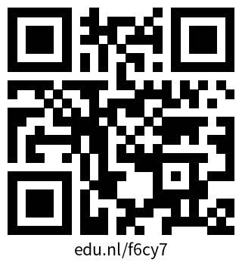
Create your ORCID ID
ORCID
Visit orcid.org
Create your ORCID ID
Make sure your information is up-to-date
Add your ORCID ID to your Pure profile at pure.tue.nl
Pure

Slide 10
Everyone has an ORCID ID registered to your Pure account?

Slide 11
Let’s do an activity

Slide 12
Activity: Whose ORCID ID is it?
Pair up with your neighbors
You will receive ORCID IDs
Find out the names for ORCID IDs

Slide 14
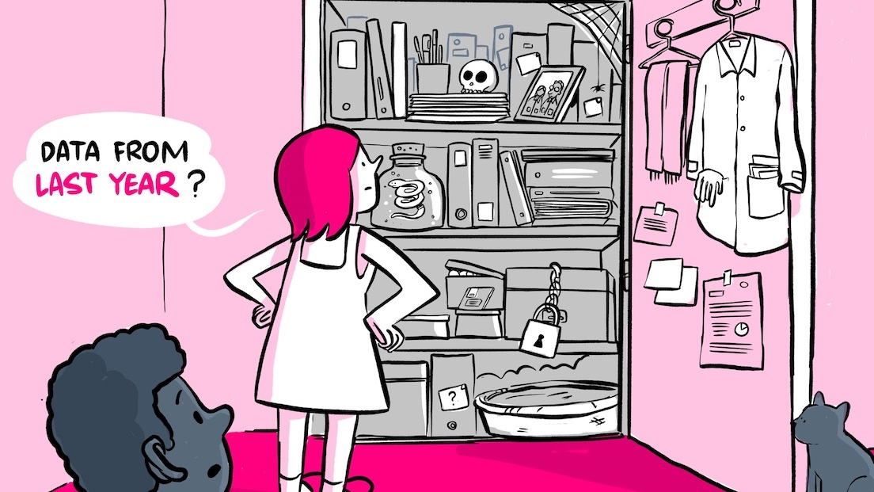


Research Data Management
Nami Sunami
Data Steward
n.sunami@tue.nl
DOI: 10.53962/gdkf-a36m
orcid.org/0000-0001-5482-8370
This work is marked with CC0 1.0
Notes:
Image: Research Data Management: making it possible to retreive data from last year. The Turing Way project illustration by Scriberia. Original version on Zenodo. http://doi.org/10.5281/zenodo.3695300

Slide 15
After this part, you’ll be able to…
Evaluate your own research data management practices in the research data life cycle
Apply strategies to make your research data Findable, Accessible, Interoperable and Reusable (FAIR)
Open & FAIR Data

Slide 16
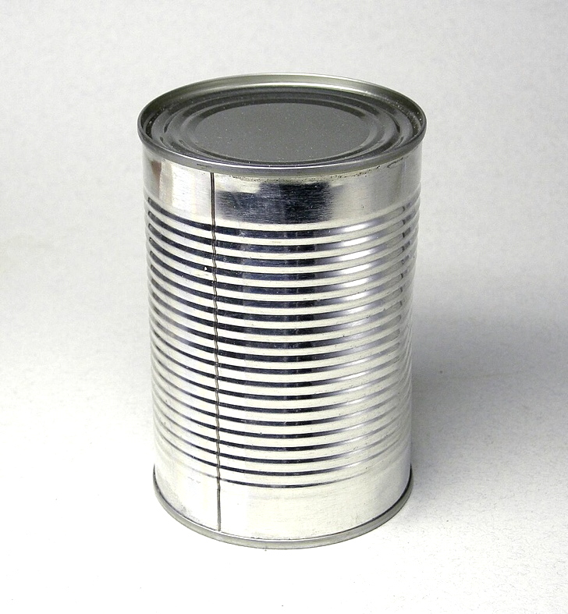
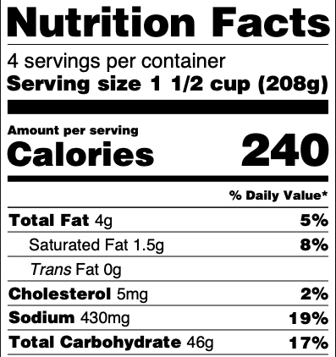
"Research Data"
Data itself
Metadata
Konservendose by Rainer Zenz, CC BY-SA 3.0, via Wikimedia Commons
Notes:
In this presentation, we use Research Data as including Data Itself and Metadata

Slide 17
“Research Data Management”
the way you collect, analyze, store, share, archive and publish research data, to satisfy the needs of current and future data users​
Notes:
Research data management concerns the way you collect, analyze, store, share, archive and publish research data, to satisfy the needs of current and future data users​.

Slide 18
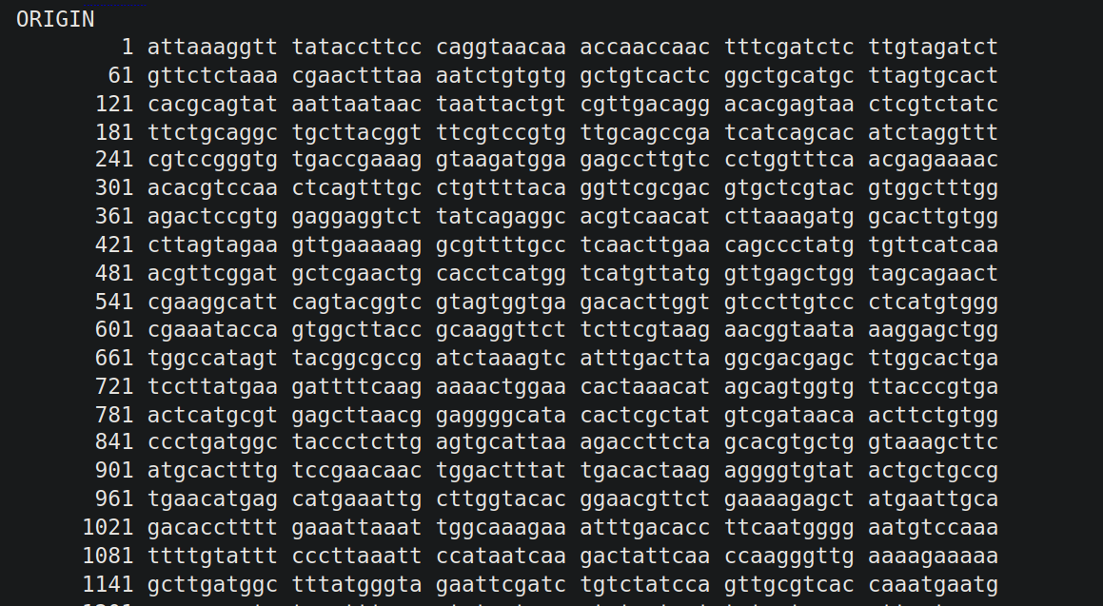
Notes:
The genome of the coronavirus sequenced by Yanmei Chen at Yong-Zhen Zhang's lab at Funan
GenBank
https://www.ncbi.nlm.nih.gov/nuccore/MN908947
https://papers.ssrn.com/sol3/papers.cfm?abstract_id=3934022

Slide 19

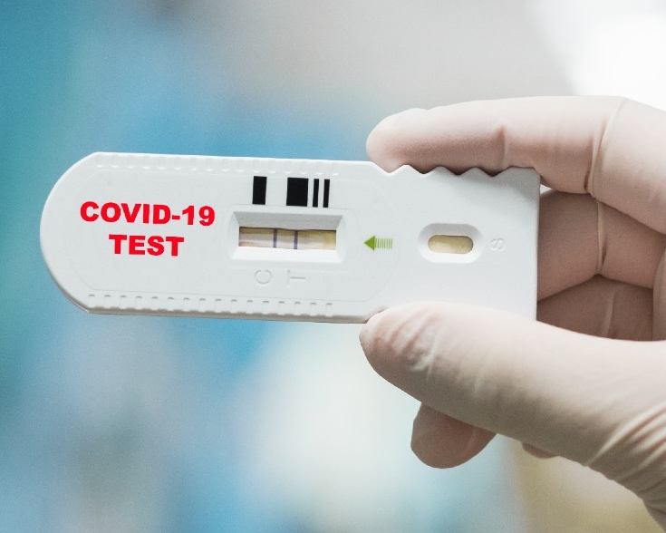
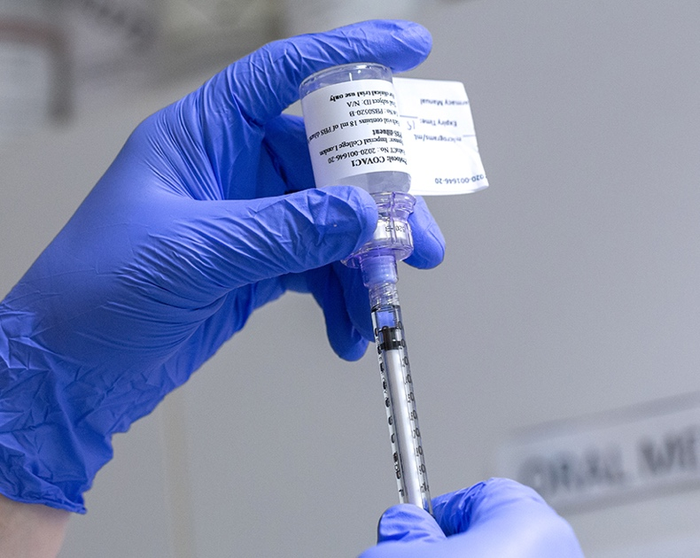

Coronavirus genome sequence
GenBank
GenBank: https://www.ncbi.nlm.nih.gov/nuccore/MN908947
Notes:
COVID test: https://images.wired.it/wp-content/uploads/2020/05/07150304/coronavirus-test-saliva.jpg
Vaccine: https://blogs.imperial.ac.uk/imperial-medicine/files/2020/09/200624_covid-19_crf_imp_vaccine_trial_0252.jpg

Slide 20
Open & FAIR Data drive innovation
(& save lives)
Notes:
Remember COVID Glad that we are alive. We are standing (and living) on the shoulder of the giant
https://en.wikipedia.org/wiki/COVID_Moonshot
https://en.wikipedia.org/wiki/Impact_of_the_COVID-19_pandemic_on_science_and_technology#Open_science

Slide 21
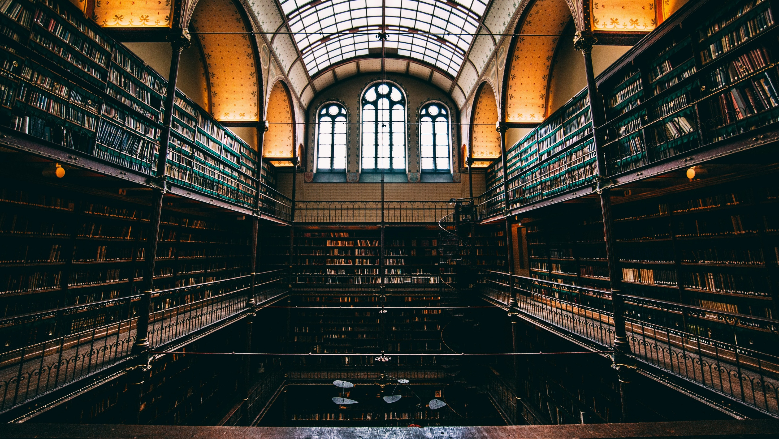
Research Data as a public good
Photo by Will van Wingerden on Unsplash
unesco.org/en/open-solutions/open-data

Slide 22
Data stewardship: Taking care of data well

Slide 23
Journals are asking for data
38% requiring data sharing
Based on 2017 data from 709 journals in life, health, and physical sciences.
Kim, J., Kim, S., Cho, H.-M., Chang, J. H., & Kim, S. Y. (2020). Data sharing policies of journals in life, health, and physical sciences indexed in Journal Citation Reports. PeerJ, 8, e9924. https://doi.org/10.7717/peerj.9924

Slide 24
What do ”Open” & “FAIR” mean?

Slide 25
Open data is data anyone can freely access, use, modify, and share for any purpose
Notes:
We can have a visual of Open Data being on one end of a continuum, before the FAIR data
(Start with FAIR, and if there's no restriction, make your data Open Data)

Slide 26
Not all data can be shared openly
FAIR Data
Notes:
Still, we can tell what’s inside: just like a canned tomato soup -> that’s why we have FAIR

Slide 27




Findable
Accessible
Interoperable
Reusable
Open Data
FAIR Data
https://www.go-fair.org/fair-principles/
Notes:
Findable and accessible can be covered by being open, but not other two

Slide 28

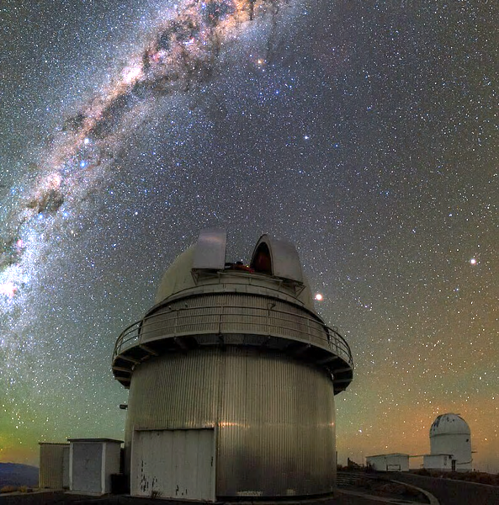
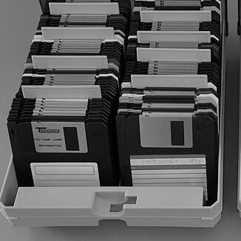
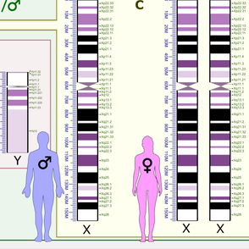
FAIR & Open
Open
Closed
Not FAIR
FAIR
Notes:
Kaggle: from the website
Telescope: By ESO/B. Tafreshi (twanight.org) - http://www.eso.org/public/images/potw1512a/, CC BY 4.0, https://commons.wikimedia.org/w/index.php?curid=39502519
ESO data can be found on https://archive.eso.org/cms.html
Floppy disks: https://commons.wikimedia.org/wiki/File:MF-2HD_Disketten_3%C2%BD-inch_floppy_disks_3%C2%BD-inch_floppy_disk_storage.JPG
Genes: https://en.wikipedia.org/wiki/File:Human_karyotype_with_bands_and_sub-bands.png

Slide 29
Open ≠ FAIR
Notes:
Open doesn’t mean FAIR

Slide 30
Metadata can always be made Open & FAIR

Slide 31
What happens to your data at the end of the project?

Slide 32





Research Data Management can go wrong
Paper
Data never to be looked at again
Create Data
Consume Data
Data loss & research waste
Notes:
Traditionally, we thought research data as something to be consumed, with a dead end

Slide 33




We can also do it better: efficient & sustainable
Plan
Share & Reuse
Collect
Process & Analyze
Archive
Adopted from RDMkit: https://rdmkit.elixir-europe.org/data_life_cycle
Notes:
Research data management concerns the way you collect, analyze, store, share, archive and publish research data, to satisfy the needs of current and future data users​.

Slide 34




Community standards, funders, and laws require good RDM
Code of Conduct for Research Integrity
TU/e RDM Policy
Funders
GDPR
Code of Conduct for Research Integrity: nwo.nl/en/netherlands-code-conduct-research-integrity
NWO Grant Rules: nwo.nl/en/nwo-grant-rules

Slide 35




Not losing data
Good RDM benefits you and your research community
Recognition
Protection for integrity
More efficient & sustainable science
Code of Conduct for Research Integrity: nwo.nl/en/netherlands-code-conduct-research-integrity
NWO Grant Rules: nwo.nl/en/nwo-grant-rules

Slide 36
How to plan for your research project

Slide 37
Data Management Plan (DMP)
A living document for the research project
Funding agencies require data management plans, reviewed by a data steward
At TU/e, you can prepare a Data Management Plan on the Research Cockpit (more on this later)

Slide 38

RDM Policy: Data Management Plan is required for all projects
Uploaded to Hora Finita at:
Approved DMP at the 9-month evaluation
Approved DMP in the PhD defense package
TU/e Research Data Management Framework Policy

Slide 39
What kind of data do you have?
A. Data from human participants
B. Sensitive Data
C. Data from external parties

Slide 40

Ethical review is required for all research involving human data at TU/e
*including anonymous / secondary data
ERB application can be submitted after creating a Data Management Plan on Research Cockpit
Research Cockpit: cockpit.research.tue.nl
Ethical Review | TU/e : tuenl.sharepoint.com/sites/intranet-ethical-review

Slide 41

Pla
Personal Data: Any data that can be traced back to a living person
Normal Personal Data
Special Category Personal Data
Privacy Handbook | UU: https://utrechtuniversity.github.io/dataprivacyhandbook/definitions.html

Slide 42
GDPR prohibits processing special categories of personal data except certain circumstances
Racial or ethnic origin
Political opinions
Religious or philosophical beliefs
Trade union membership
Genetic and biometric data for identification
Sex life or sexual orientation
Health Data
Data Processing Impact Assessment (DPIA) may be needed
Contact your data steward if you plan to process special categories personal data
Privacy Handbook | UU: https://utrechtuniversity.github.io/dataprivacyhandbook/definitions.html

Slide 43

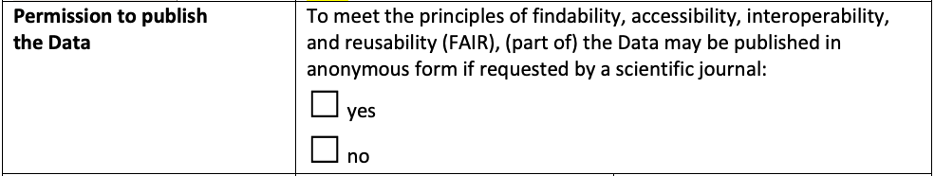
If you are getting data from an external party, it’s best to have an agreement about data
Will your party agree to publish your data?
Data Sharing Agreement Template TU/e Receiver
Agreements | TU/e: https://tuenl.sharepoint.com/sites/intranet-privacy-security/SitePages/agreements.aspx

Slide 44

When writing a grant proposal, it’s best to reserve funding for RDM-related costs
“Data management and making the data FAIR (assigning DOI, describing the data, assigning metadata to the data, etc.) is part of the ongoing research activities of involved researchers. Although we do not foresee any extra expenses, a budget of €5000 is reserved for RDM purposes.”
Costs of data management | UU https://www.uu.nl/en/research/research-data-management/guides/costs-of-data-management

Slide 45
We’ll try out the Research Cockpit later today

Slide 46
Collecting Phase

Slide 47
Set your folder structure and document it in the README file
.
├── README.md
├── metadata.json
├── data/
│ ├── raw
│ └── processed
├── code/
├── output/
└── documentation/
├── methods
├── lab_notebooks
└── administration

Slide 48
Make a README file to make your data human-friendly
No one can read your mind—not even you in the future
Make a README: makeareadme.com/
Guide to writing “readme” style metadata | Cornell: data.research.cornell.edu/data-management/sharing/readme/

Slide 49

A metadata file makes your data machine-readable
You can complete a dataset form on 4TU.ResearchData or Zenodo, download the metadata file, and save it together with your data.
*You can also manually create metadata file using DataCite Metadata Generator
Photo by AltumCode on Unsplash
DataCite Metadata Generator: dhvlab.gwi.uni-muenchen.de/datacite-generator/

Slide 50
Name files meaningfully, distinctly, and consistently
No special characters. Whitespaces are discouraged.
Case style: camelCase, PascalCase, snake_case, or kebab-case?
Use ISO date format: “2024-07-03”
Turing Way: https://book.the-turing-way.org/project-design/filenaming.html

Slide 51
Storage options at TU/e

Slide 52
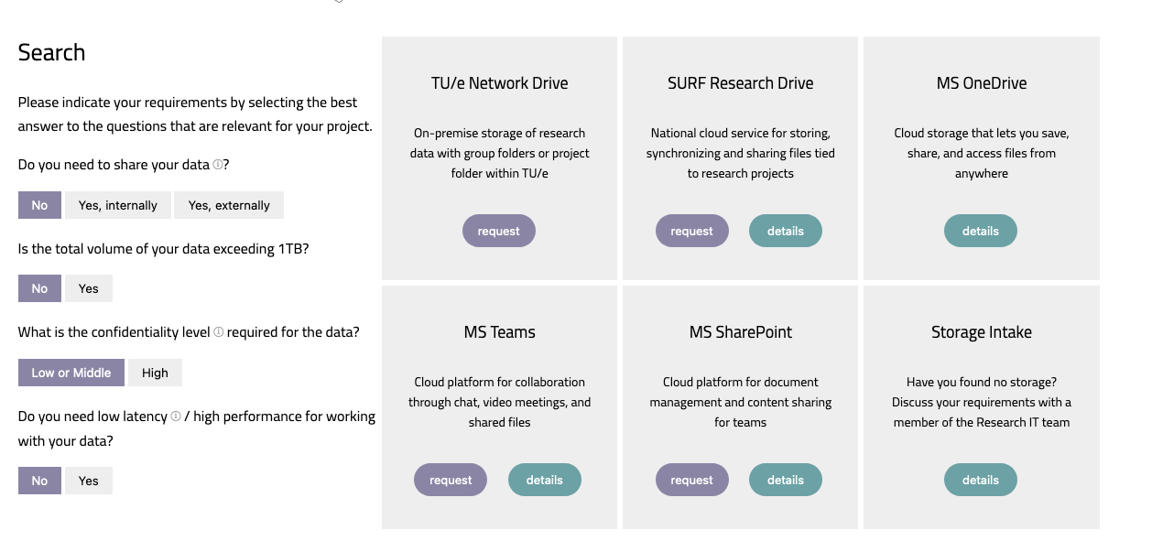
Storage Finder at Solution Searcher
https://openpar.pages.tue.nl/solution-searcher/category-storage.html

Slide 53
Where do you store your data?
A. TU/e Network Drive
D. OneDrive
B. SURF Research Drive
E. Other
C. Teams / SharePoint

Slide 54




Network Drive
TU/e Storage Options
Security
Scalability
Best
Best
(External sharing not possible)
(~100 TB)
Research Drive
Good
Good
(~10 TB)
Teams / SharePoint
OK
Good
(~2.5 TB)
*OneDrive is recommended for student project only

Slide 55

You can encrypt your data using Cryptomator in a vault and store it in any storage solution
You can manage access using Cryptomator Hub
Learn more about Cryptomator Hub on the Research Cockpit: https://cockpit.research.tue.nl/helpcenter/research/portal/11/article/2452390165

Slide 56

Only sending data one-time? Then use SURFfilesender
Remember to turn on encryption
SURFfilesender: filesender.surf.nl/
Do not send data over email!

Slide 57
Processing & Analyzing Data

Slide 58
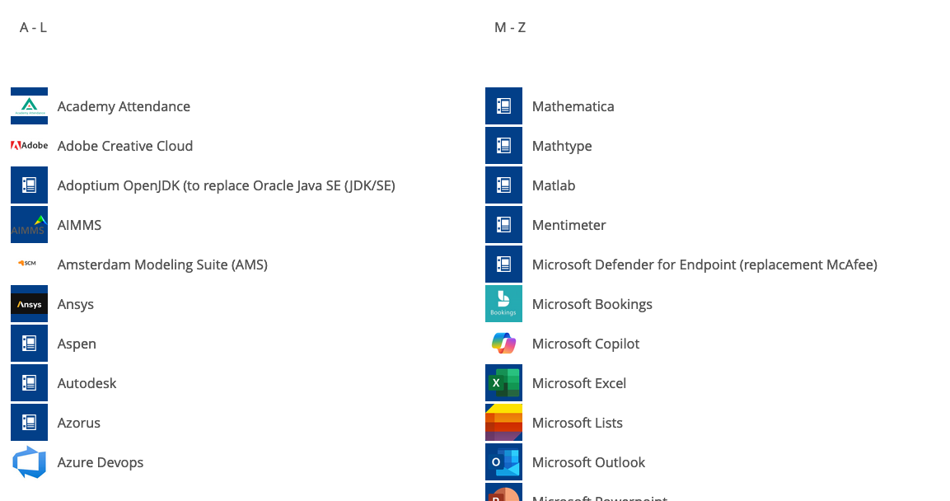
You can find available tools on Topdesk
TU/e Software | Topdesk

Slide 59


The recommendation is to use open-source tools, whenever possible.
R
Python

Slide 60
If the original dataset is in a proprietary format, convert it to an open file format.
e.g., text file, HDF5, NetCDF

Slide 61
Do you need to use proprietary tools?
Any opportunities for using open tools?

Slide 62
Archiving
Share & Reuse

Slide 63
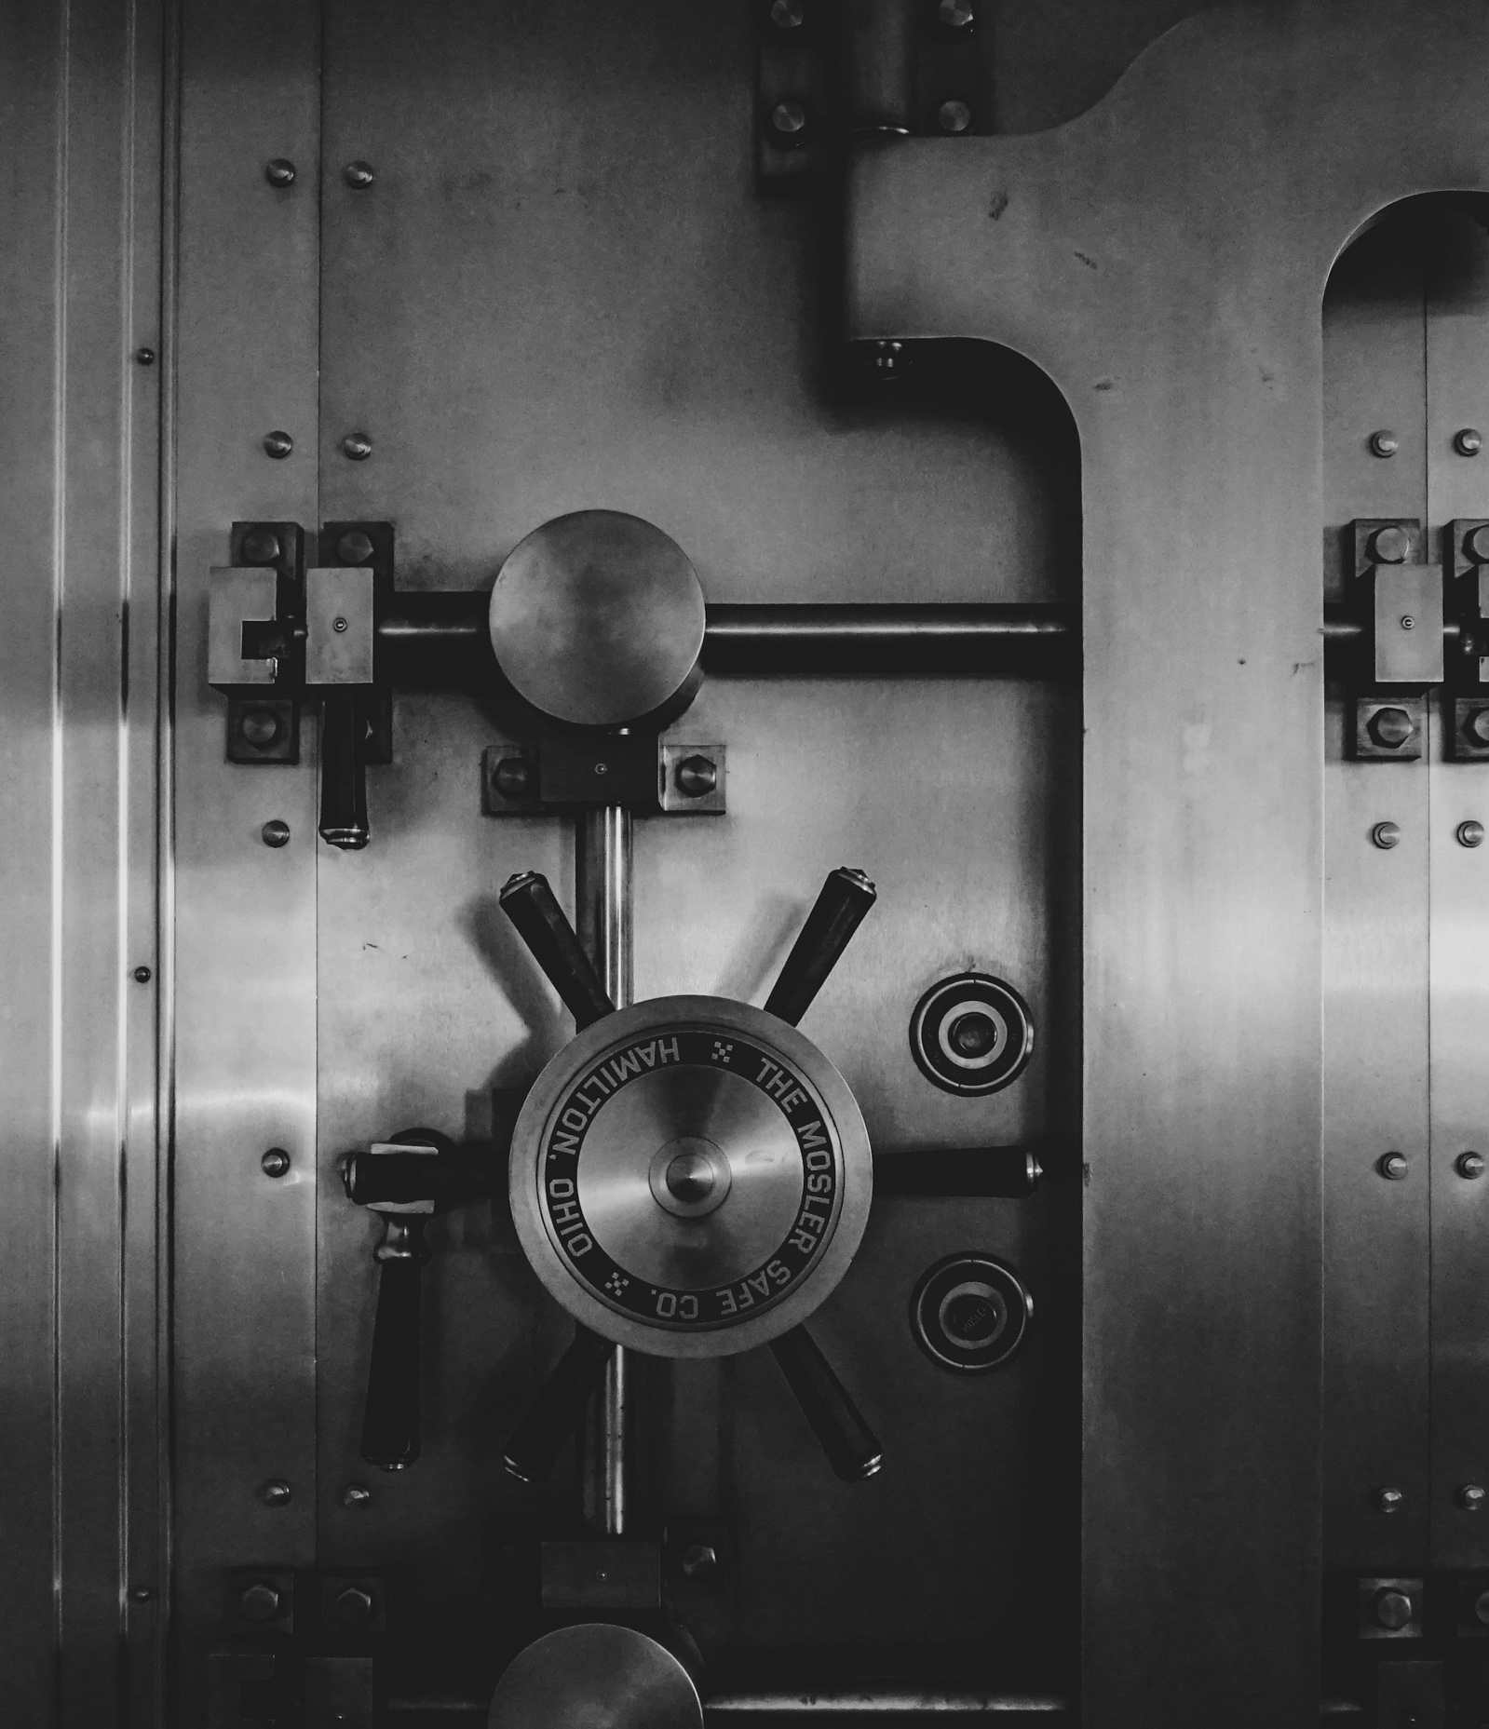
Archiving: keeping data to demonstrate the integrity of research
Usually, each publication requires an archival package
Archival package is only accessed when it’s needed
Photo by Jason Dent on Unsplash

Slide 64
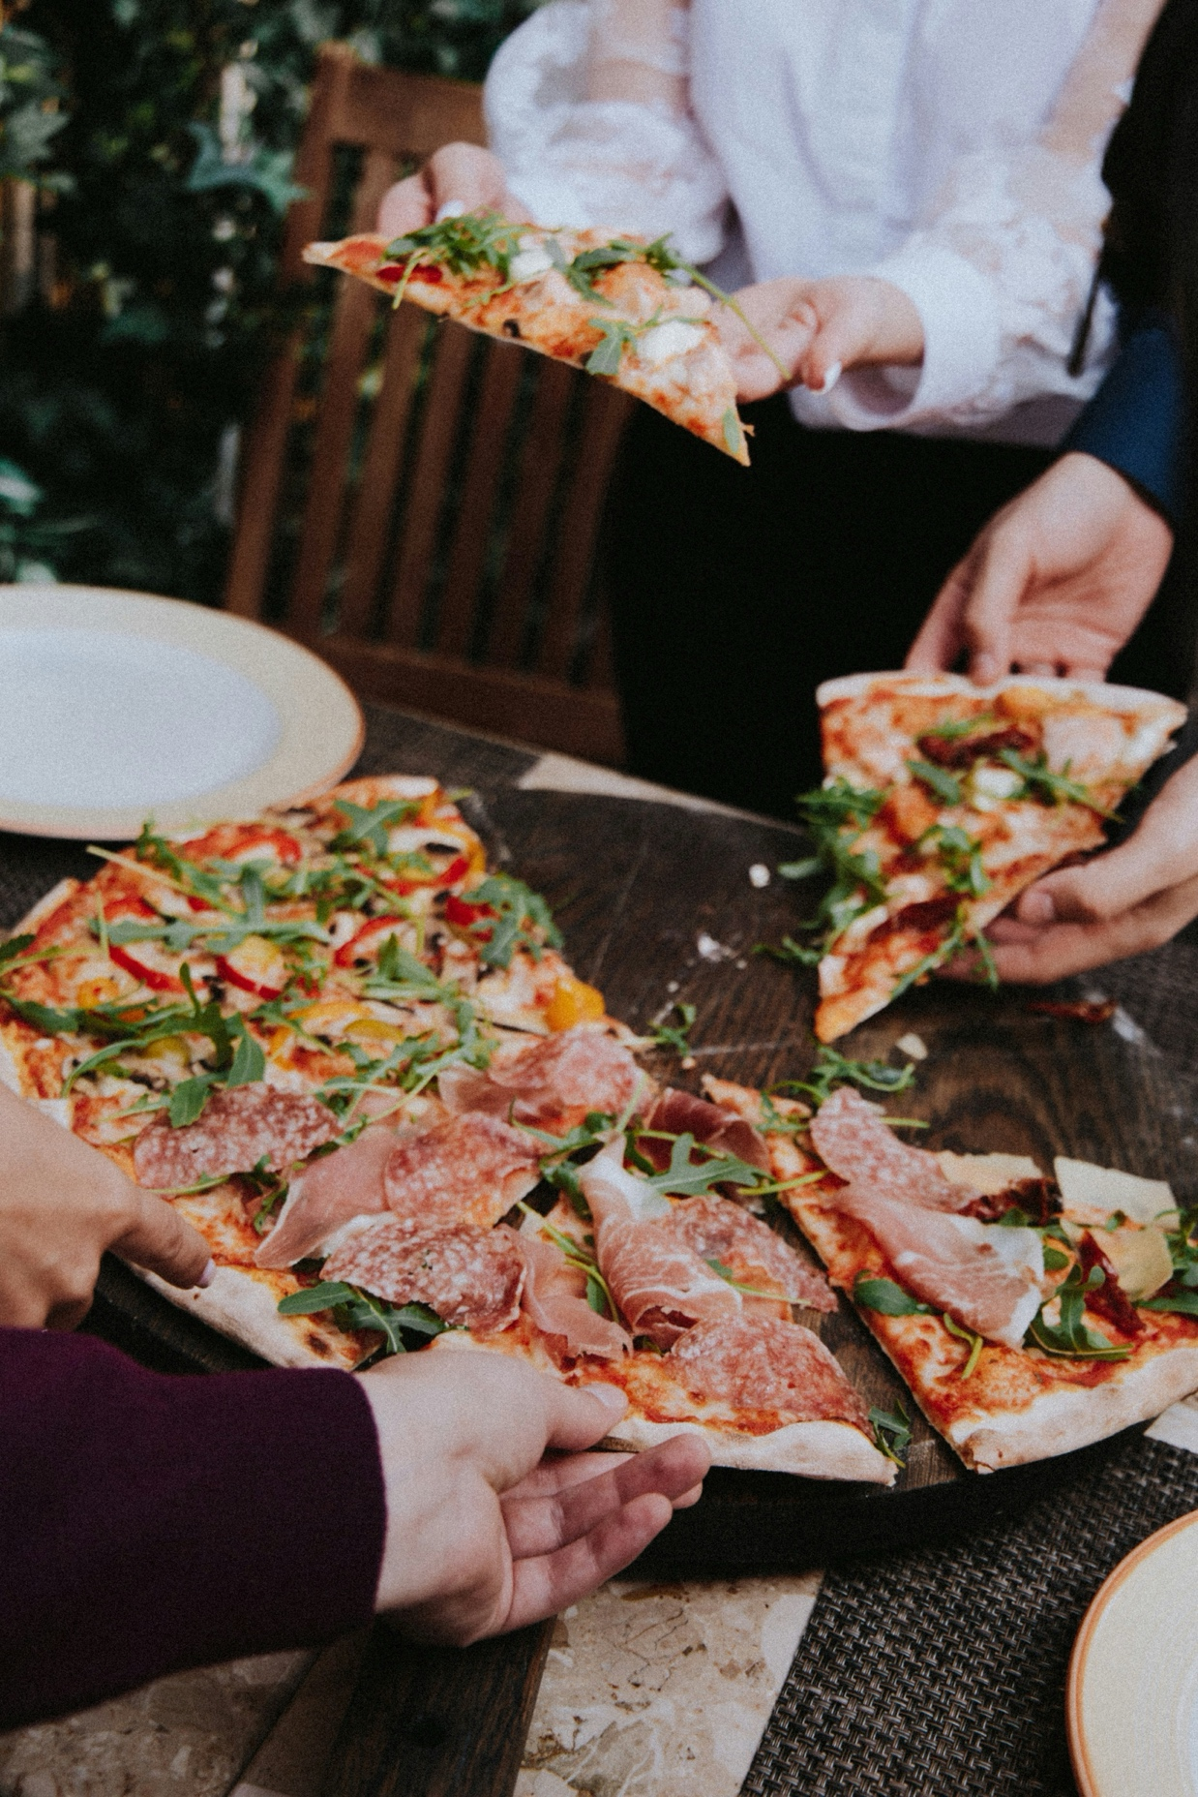
Sharing: Creating a publication data package to share your data
The goal is to share data with future data users (can be you)

Slide 65




Publication Package
Archival Package
To share
To demonstrate integrity
Main Goal
Public
Restricted
Access
By default

Slide 66


You can deposit data in a data repository & connect your publication.
You can use generic repositories, such as 4TU.ResearchData & Zenodo.
Your discipline may have a specialized data repository. Visit re3data.org to find out.

Slide 67


When sharing your research, assign an open license, for example
Data, documentation, non-code materials
Code
CC BY 4.0
MIT
https://chooser-beta.creativecommons.org/
https://choosealicense.com/

Slide 68
Share your data as openly as possible as closed as necessary
That said, look out for limitations related to privacy, intellectual property, or data agreements
FAIR Data Management in Horizon 2020: ec.europa.eu/research/participants/data/ref/h2020/grants_manual/hi/oa_pilot/h2020-hi-oa-data-mgt_en.pdf

Slide 69
The future user of your data may be you

Slide 70
Managing Research Data can be overwhelming…

Slide 71
It’s best to plan ahead to avoid chaos at the end

Slide 72
Effort
“What did I do again?”
“Where’s my data?”
“No time to spend for planning now.”
Project Start
Project End
Notes:
(In the past, we scramble ourselves to structure metadata and data at the end of the project )
But, it’s worse way to do it—time consuming, accuracy, remembering everything, “past you”

Slide 73
Ideal: Start with the end in mind

Slide 74
Effort
Completing a Data Management Plan
Data publication & archiving as planned
Project Start
Project End

Slide 75
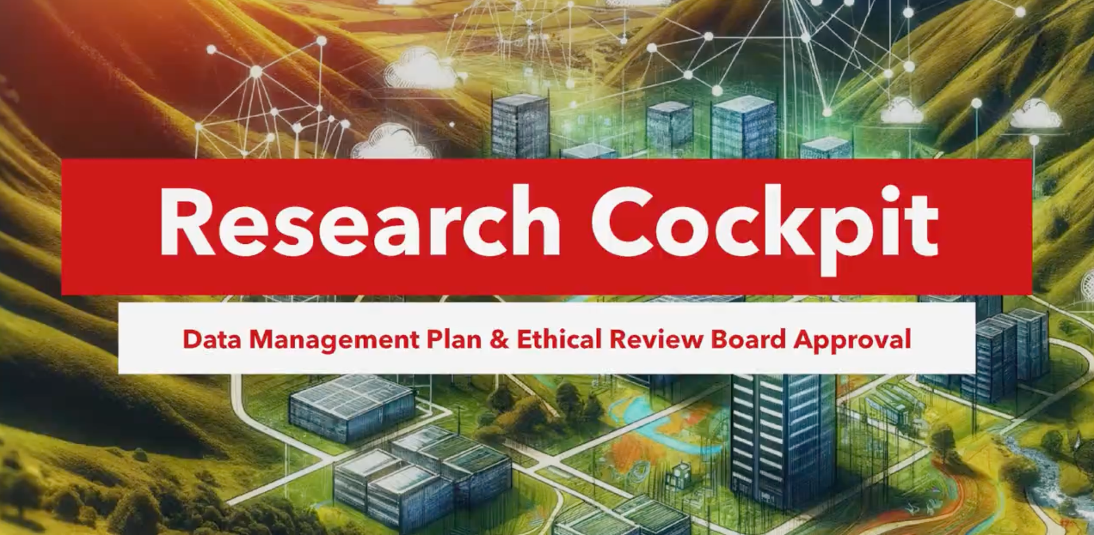
Research Cockpit
https://cockpit.research.tue.nl

Slide 76
Let’s try out the Research Cockpit!

Slide 77
General workflow
Project Registration
Data Management Plan
If needed
Ethics Application

Slide 78
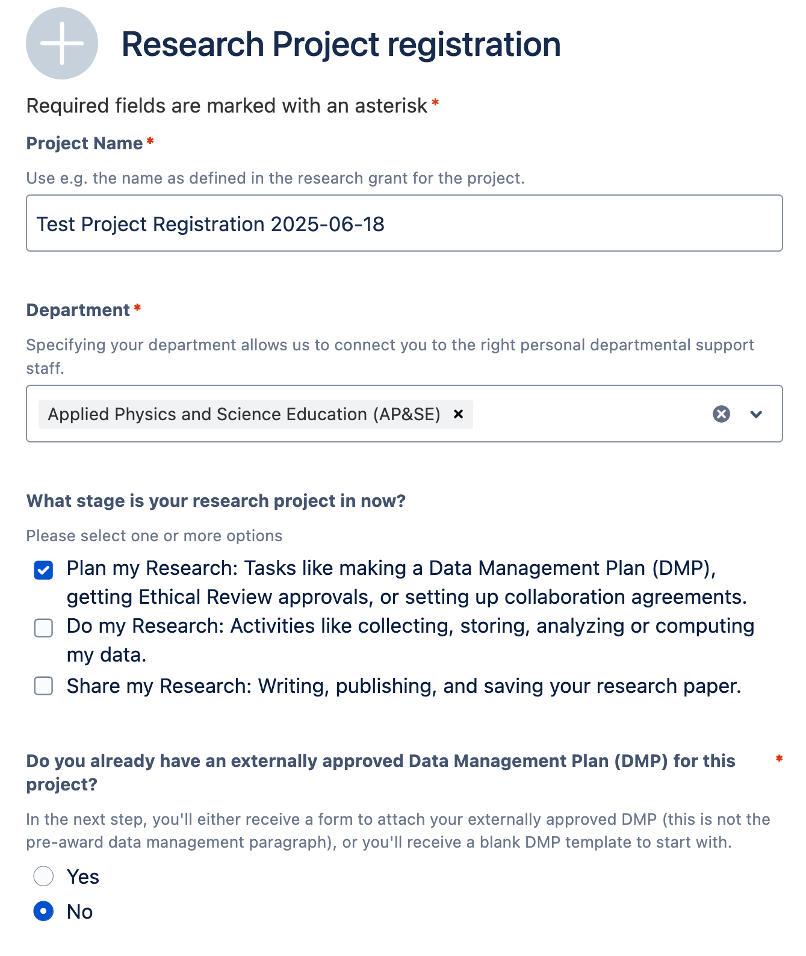
Project Registration
Visit Research Cockpit (cockpit.research.tue.nl)
Find “Data Management Plan”
Find ”Create a Data Management Plan
Fill in Research Project Registration
Click “Send”

Slide 79
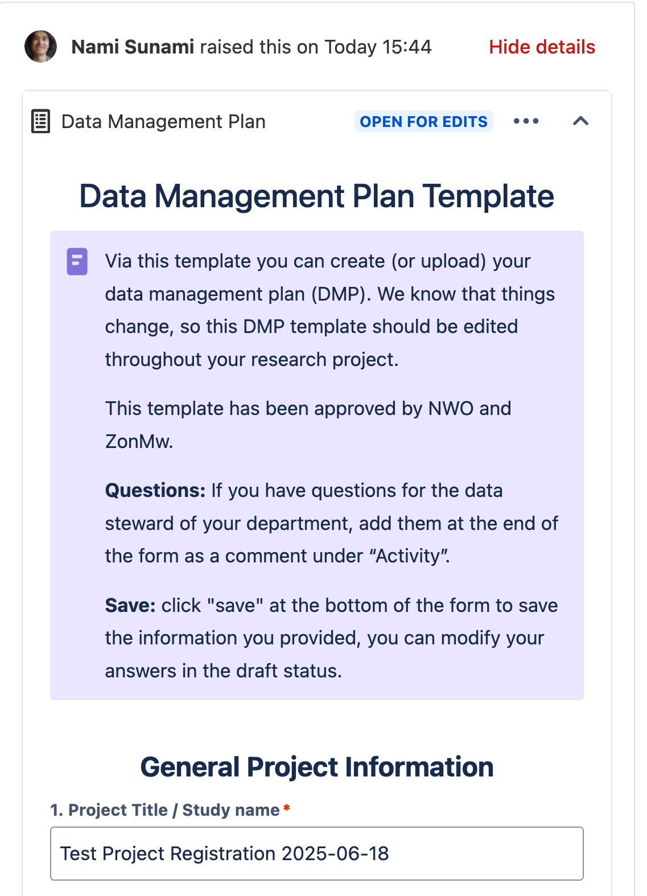

Data Management Plan (DMP)
Go to your avatar -> Requests
Find your Draft DMP
Fill in the information in the DMP
You can share your DMP with your collaborators
If you no longer need the DMP, please retract it.

Slide 80
How was your experience with the Research Cockpit?

Slide 81
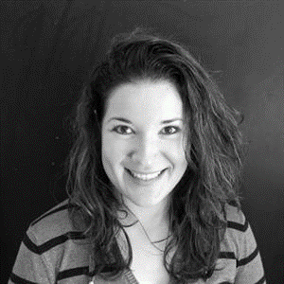
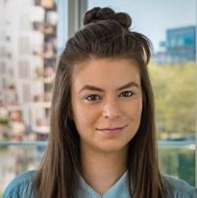
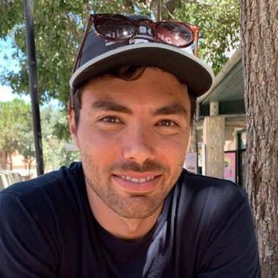
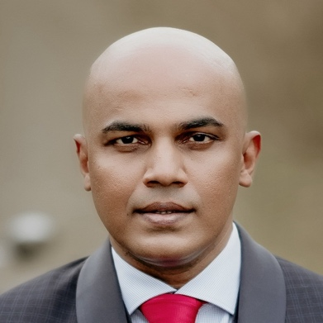
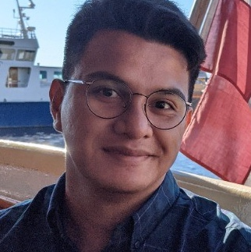
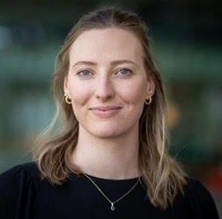
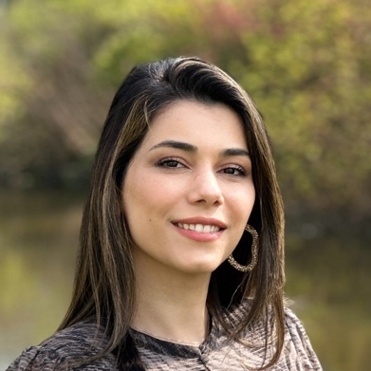
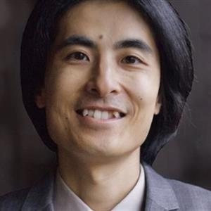
Don’t hesitate to reach out to your Data Steward
Liz Guzman-Ramirez
Coordinator
Angela Aleksovska
EE
Davide Nardi
M&CS
Jay Nair
IE&IS
Jonathan Genora
ID
Lucia Forrová BE
Neda Norouzi
BME, ME
Nami Sunami
CE&C, APSE
rdmsupport@tue.nl
rdm.tue.nl
Data Stewards | SharePoint (login required)

Slide 82
Thank you
More info on RDM
Contact Data Steward
rdmsupport@tue.nl
Data Stewards | Intranet
TU/e Research Data Management Handbook
Search Storage | Storage Searcher
Create a DMP/ ERB
Research Cockpit

Slide 83
Icons in this slide deck are from Lucide, open-source icon library (https://lucide.dev/icons/rainbow)
Image are from:
Unsplash: https://unsplash.com/
Turing Way: https://book.the-turing-way.org

